Slide 1
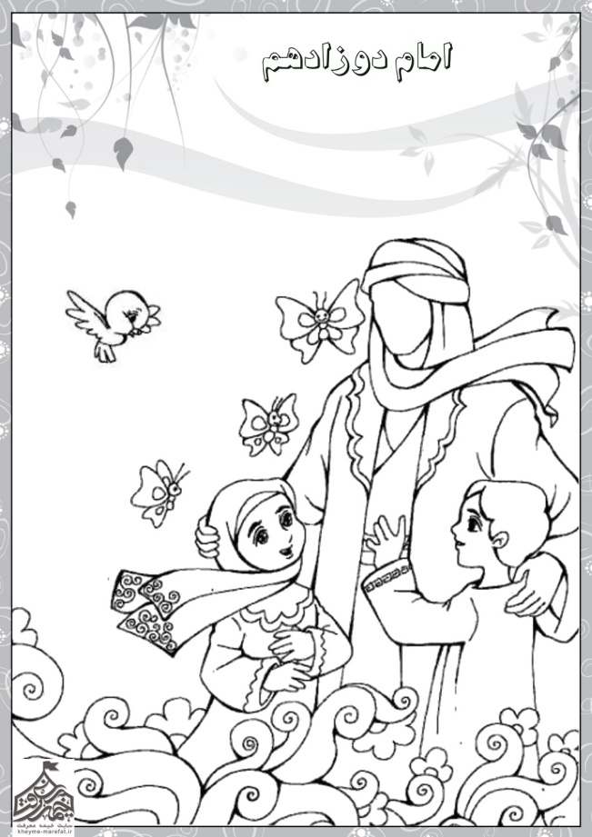
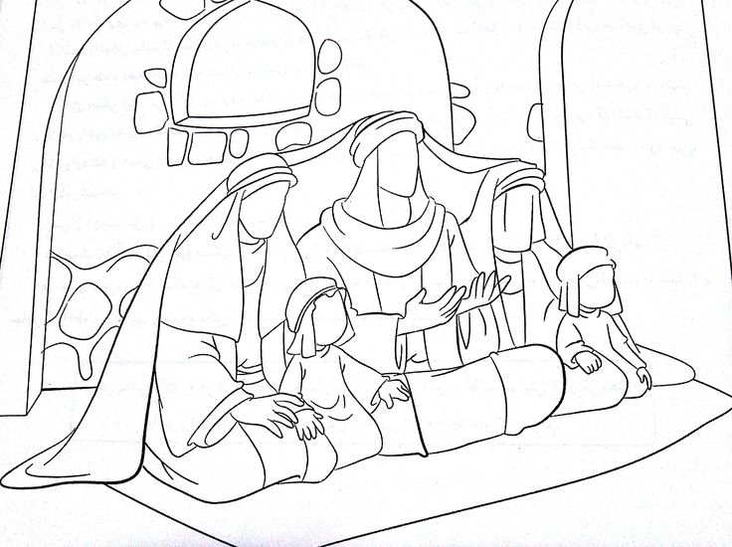
Day 1
Prophets and Imams
العلوية
Name..........................
Muharram 1440
Choose a name to fill in the blanks
Nabi Mohammed pbuh
Imam Ali as
Imam Mehdi aj
...............................................is the final prophet.
The first Imam is ............................................ while the
12th and final Imam is.......................................................
Imam.........
Nabi...........
Write the names of the five people under the cloak
Imam.........
colour
Lady...........
Imam.........
We have 12 Imams. Imam Mehdi aj is our last Imam. He is alive and loves us ☺
Ahlul Kissa

Slide 2
العلوية
العلوية
Ahlul Kissa
Ahlul Kissa
العلوية
العلوية
Ahlul Kissa
Ahlul Kissa
Day One
Scissors
Glue
Colours
straws
Give each child a picture to colour, then use the attached rectangle to stick around a straw to make a flag

Slide 3
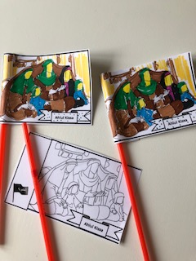
Day 1
Prophets and Imams

Slide 4
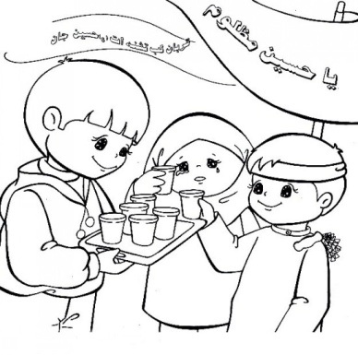
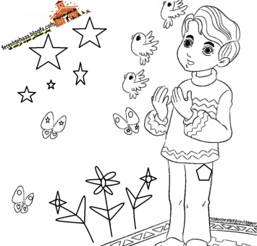
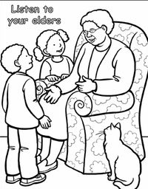
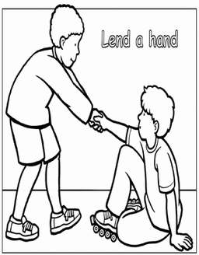
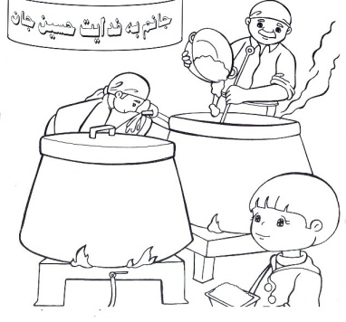
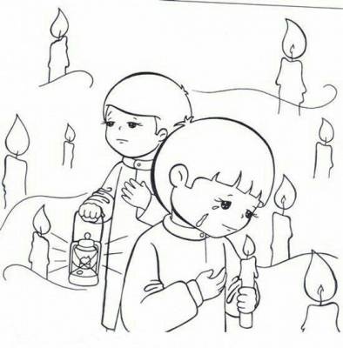
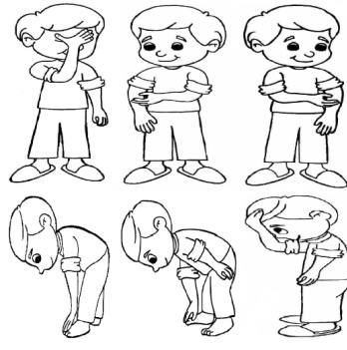
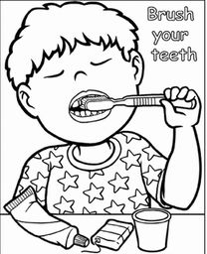
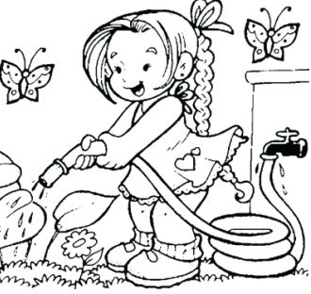
Day 2
Imam Hussain as
العلوية
Name..........................
Muharram 1440
WORD SEARCH
K | a | r | b | a | l | a | d | n | T
F | j | W | a | t | e | r | r | i | e
l | p | h | H | u | s | s | a | i | n
a | B | l | a | c | k | u | h | o | t
g | A | s | h | o | o | r | a | i | h
Hussain
Karbala
Tenth
Ashoora
Black
Flag
Water
Colour in the pictures of the acts we do to mourn Imam Hussain as
Then colour these pictures of how Imam Hussain as influences our daily lives

Slide 5
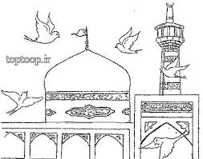
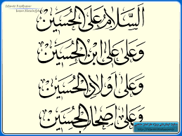
Day 2 Needed Scissors glue colours gold pen or sequins to decorate
Each child get a strip, colours it, folds it and glues the end to form a cube
G
L
U
E
G
L
U
E
G
L
U
E

Slide 6
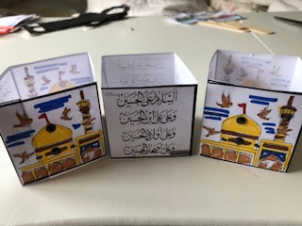
Day 2
Imam Hussain as

Slide 7
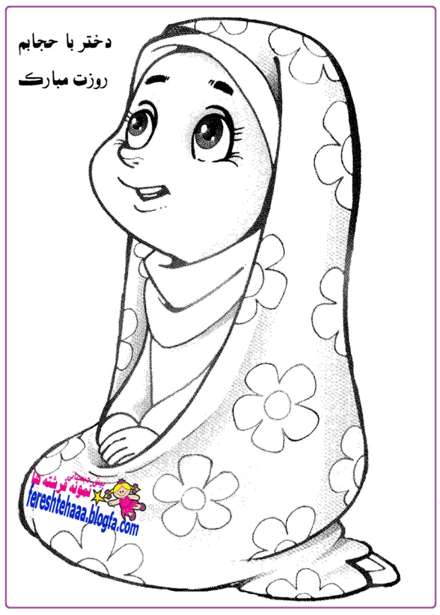
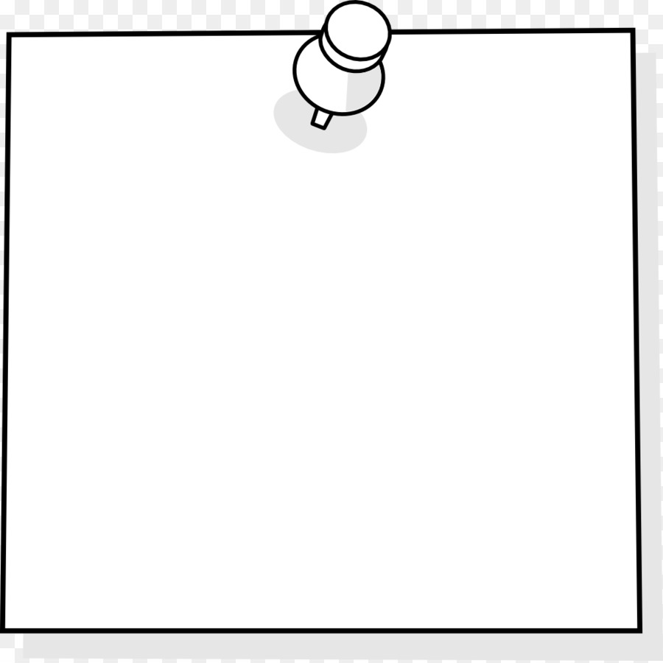
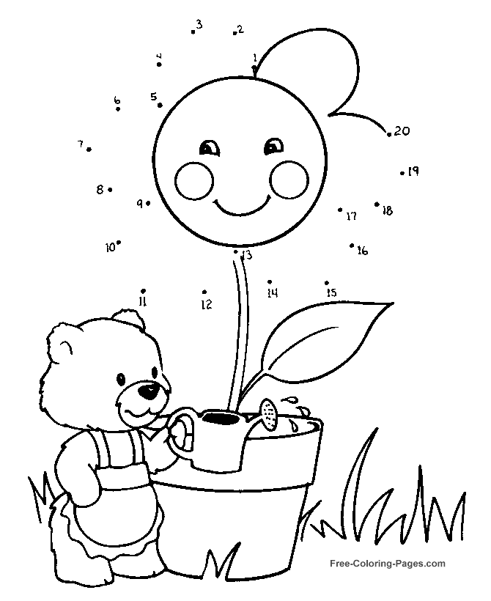
Day 3
A child named Ruqaya
العلوية
Name..........................
Muharram 1440
Please use pretty colours to colour
me ☺
I am the daughter of ..................
I felt tiered and ...........
I witnessed the battle in .................
I was only .......... years old
I asked to see my father when I was taken prisoner to ................
رقية
Imam Hussain as
I am
Ruqaya.
Choose the correct words to fill in my details
Colour the name Roqaya in Arabic
3
I learn from Imam Hussain as to be nice and kind to the environment
Dot to dot
Ma
N
N
E
R
S
Karbala
Sham
Thirsty

Slide 8
Day 3
Needed:
Scissors
Colours
Tape
ribbon
each child gets a picture to colour, cut and attach a ribbon to make a necklace
العلوية
Roqaya, the beloved daughter of Imam Hussain as
العلوية
العلوية
Roqaya, the beloved daughter of Imam Hussain as
Roqaya, the beloved daughter of Imam Hussain as

Slide 9
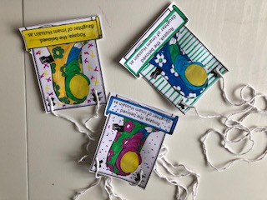
Day 3
A child named Ruqaya

Slide 10
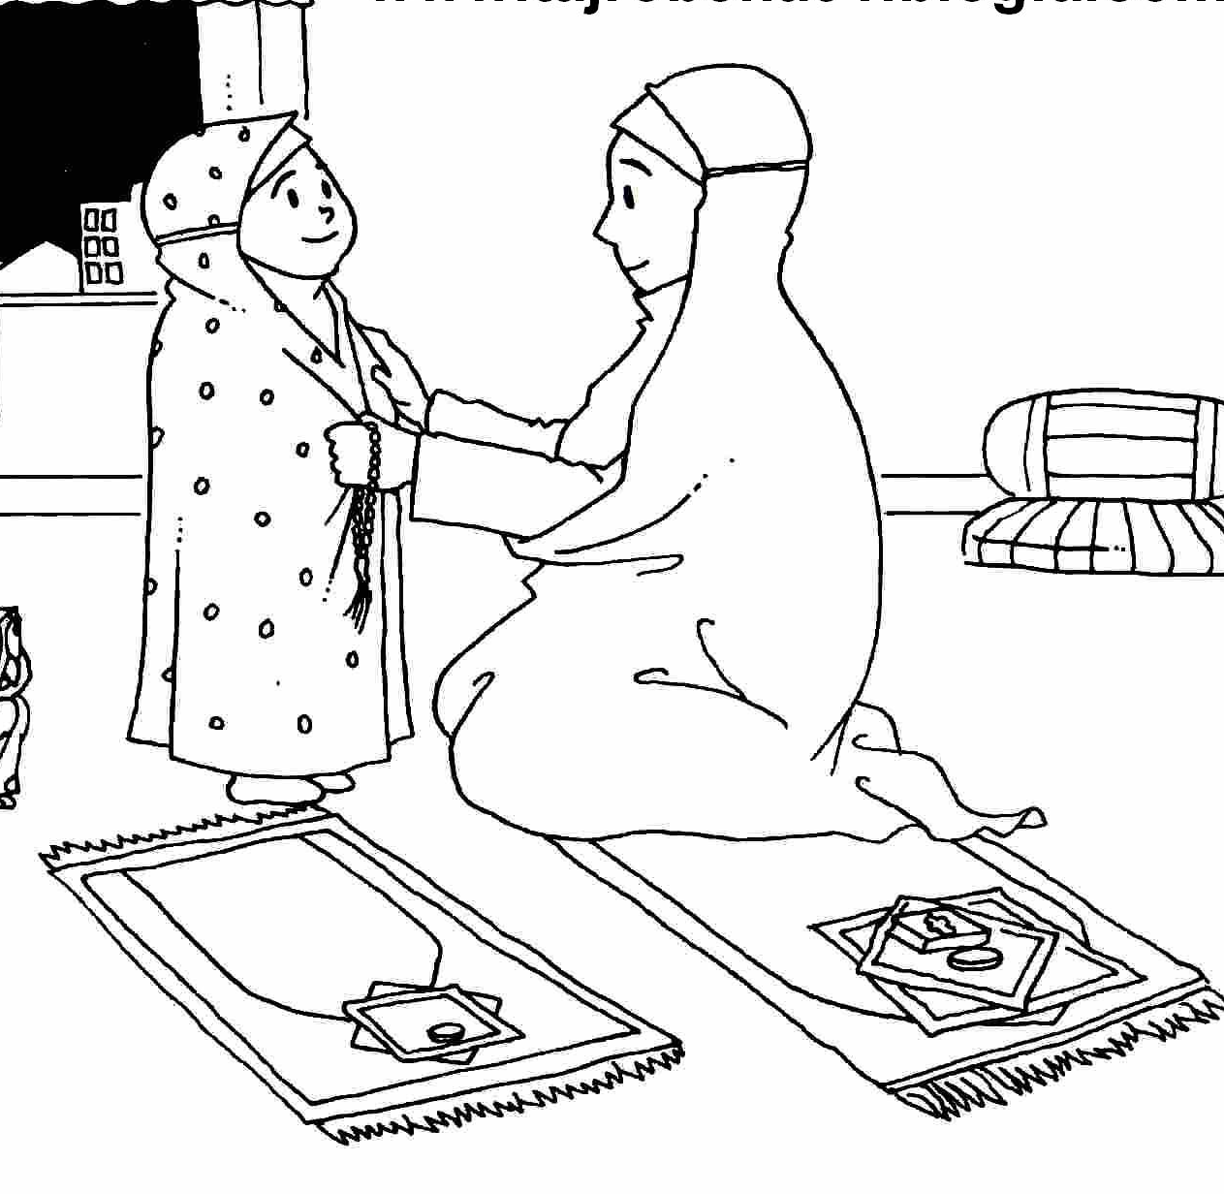
Day 4
Um Al Baneen
العلوية
Name..........................
Muharram 1440
Sons
Four
Baneen
Abbas
Ali
Karbala
e | F | o | u | r
B | t | i | K | o
A | b | b | a | S
n | k | c | r | o
e | o | e | b | n
e | u | p | a | s
n | z | A | l | i
b | r | w | a | m
Connect
Were martyred in Karbala
Find these 6 words
Um AlBaneen was the wife of
I learn from Um AlBaneen the influence a mother can have on her children by having values and being a good role model.
Imam Ali as
She had 4 sons who...
Colour
Ma
n
n
R
R
s&
Mo
r
a
l
s
Colour
AlAbbas as
She is the mother of...

Slide 11
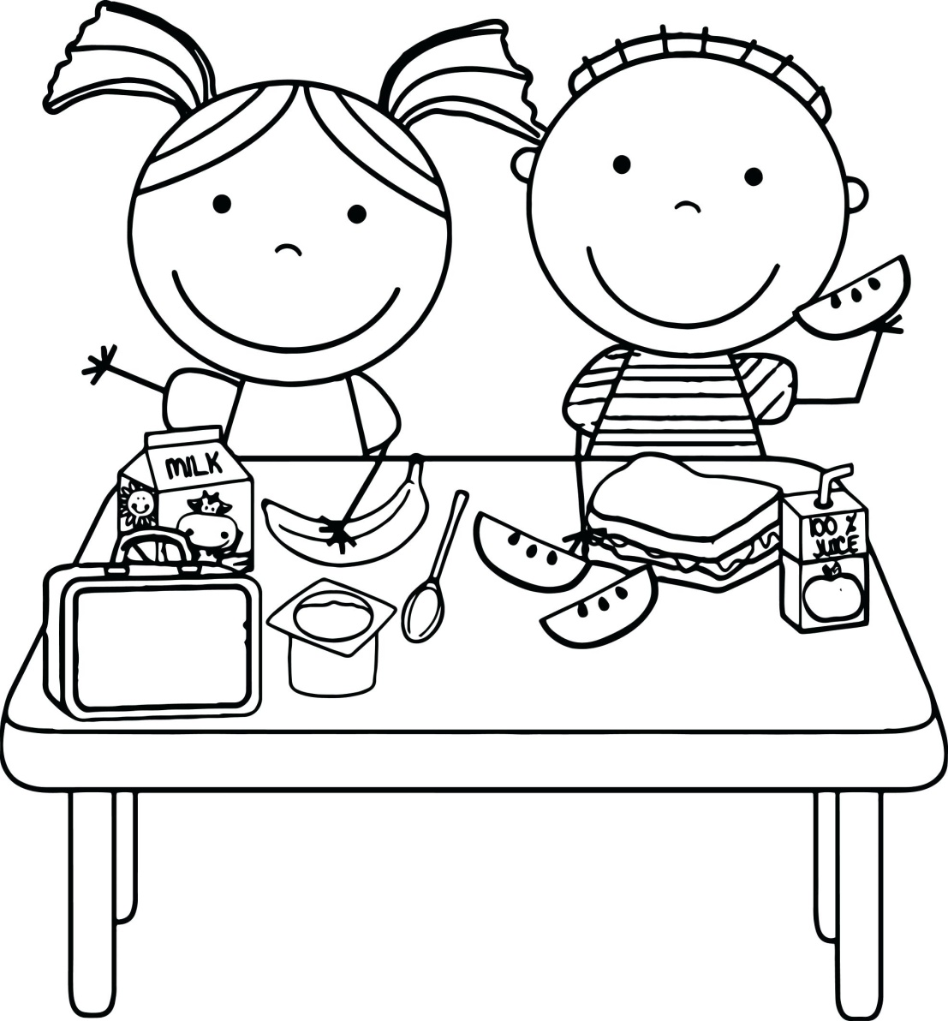
العلوية
العلوية
العلوية
We say Thank You Allah for all His blessings
We say Thank You Allah for all His blessings
We say Thank You Allah for all His blessings
Day 4
Needs: colours glue popsicle sticks
Each child is given a picture to colour and stick on a popsicle stick
العلوية
العلوية
العلوية
We say Thank You Allah for all His blessings
We say Thank You Allah for all His blessings
We say Thank You Allah for all His blessings

Slide 12
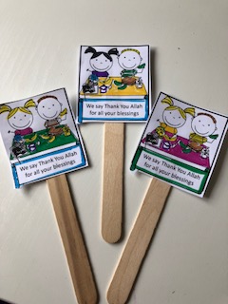
Day 4
Um Al Baneen

Slide 13
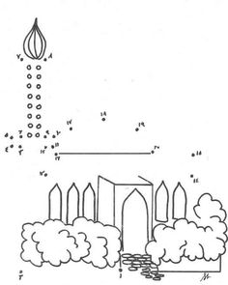
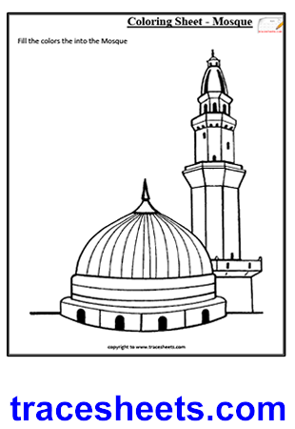
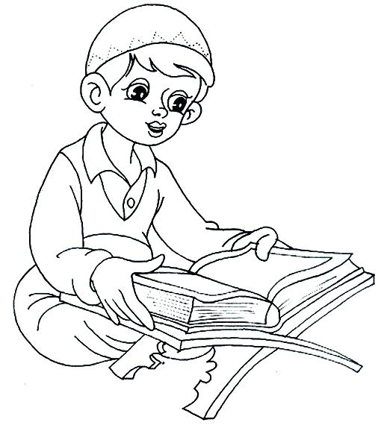
Day 5
Muslim Bin Akeel
العلوية
Name..........................
Muharram 1440
Fill in the blanks:
Muslim Bin Akeel travelled from .............. to ...................
to gather the supporters of Imam................as
colour
Dot to dot
Hussain
Kufa
Madinat
I learn from Imam Hussain as that reading and understanding the Holy Quran is important to every Muslim.
Ma
n
n
R
R
s&
Mo
r
a
l
s
M | b | K | u | f | a
u | Q | u | r | a | n
s | m | u | d | a | i
l | e | t | t | e | r
i | m | a | m | w | M
m | a | d | i | n | a
Madina
colour
Kufa
Quran
letter
Muslim
Imam
Find the above words in the Word search

Slide 14
Day 5
Each child is given a letter sheet and envelope, to fill in and colour then place in the envelope
Needed: colours scissors envelopes and a lot of love!
Dear Imam Mehdi,
I love you very much and
when you appear, I will be your supporter.
Love from
......................
Dear Imam Mehdi,
I love you very much and
when you appear, I will be your supporter.
Love from
......................
العلوية
العلوية

Slide 15
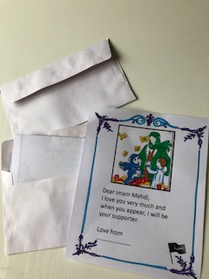
Day 5
Muslim Bin Akeel

Slide 16
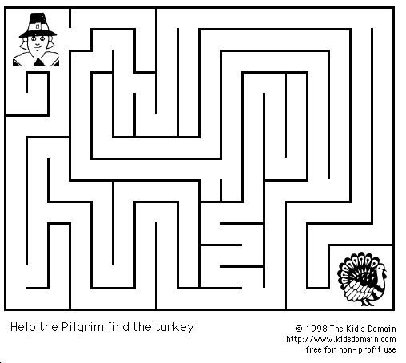
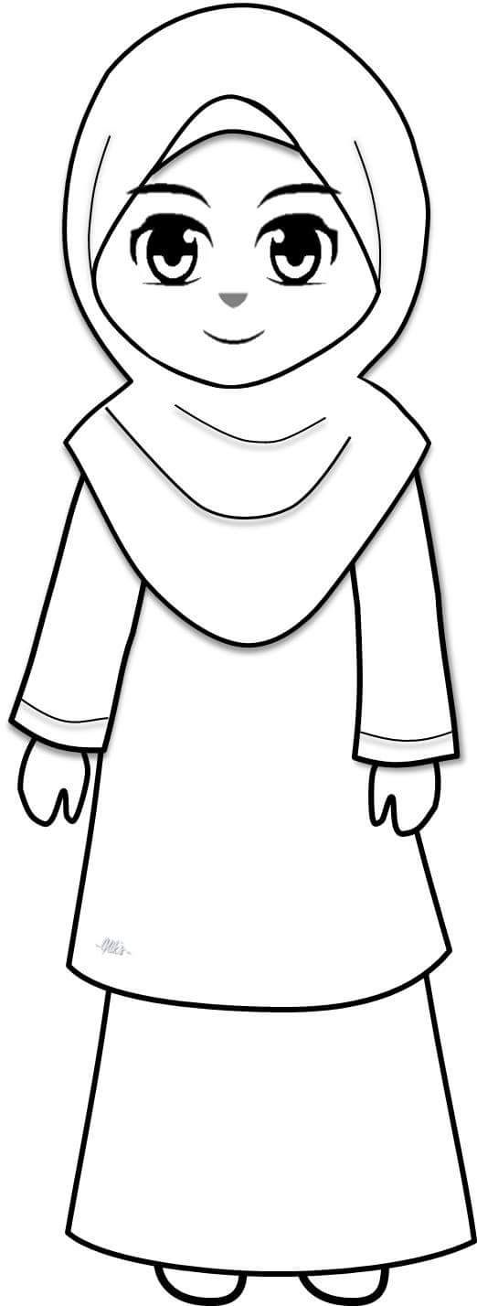
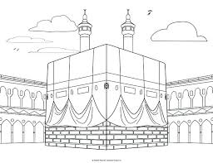
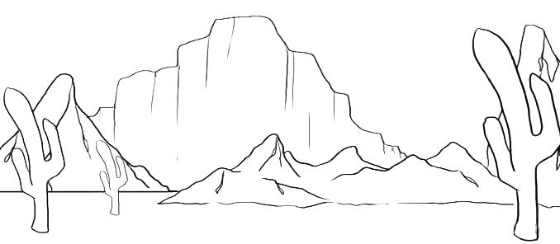
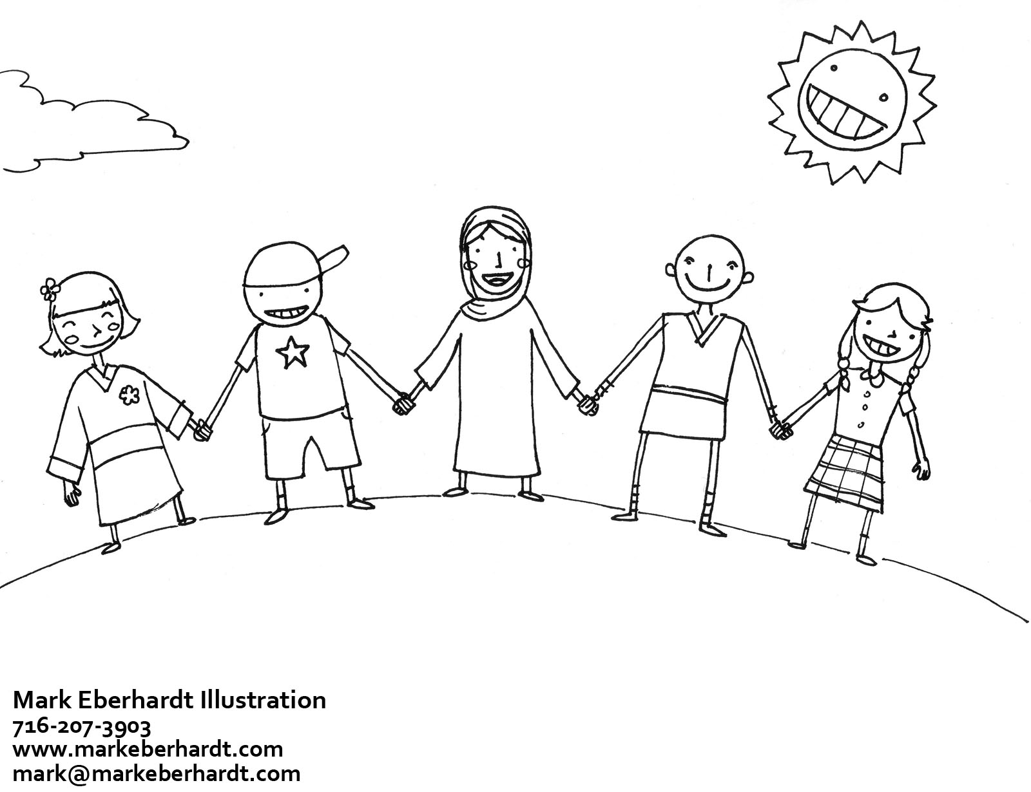
Day 6
John and Wahab (Ansar)
العلوية
Name..........................
Muharram 1440
Write the name of your non muslim friend or neighbour who you like
..............
Help the girl find her way to the Holy Kaaba
I learn from Imam Hussain as to be nice to everyone, no matter what their religion, colour or race
Choose the correct words to fill in the blanks
John was a ...................
He loved Imam Hussain and came to .................... him.
.................... was not a muslim. He was .................... , but he loved Imam Hussain as and fought for him in ..........................
Colour
Ma
n
n
R
R
s&
Mo
r
a
l
s
colour
defend
Slave
Karbala
Christian
Wahab

Slide 17
DAY 6
Each child gets a copy to colour then stick on a paper plate
Needs
Colours
Scissors
Glue
paper plates
string
العلوية
We love everyone even if we are different ☺

Slide 18
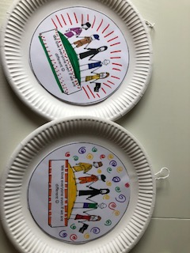
Day 6
John and Wahab (Ansar)

Slide 19
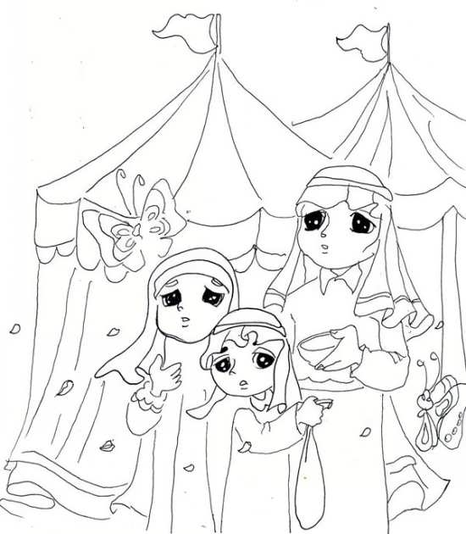
Day 7
Al Abbas as
العلوية
Name..........................
Muharram 1440
Fill in the blanks:
AlAbbas
Thirsty
Drink
water
The children were very ..........
They asked ............... to get them ............... to ..............
Write the name of four different people from Ashoora
I learn from Ashoora to remember the thirst of Imam Hussain and his family when I drink water
colour
colour
Ma
n
n
R
R
s&
Mo
r
a
l
s
Colour

Slide 20
Every time I drink water, I send my salams to Imam Hussain as
Every time I drink water, I send my salams to Imam Hussain as
Every time I drink water, I send my salams to Imam Hussain as
Every time I drink water, I send my salams to Imam Hussain as
العلوية
العلوية
العلوية
العلوية
Day 7
Each child is given an image of a bottle to colour then stick to a bottle of water
Needed
Colours
Glue
Water bottles

Slide 21
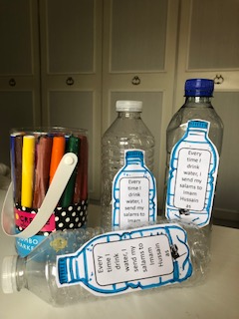
Day 7
Al Abbas as

Slide 22
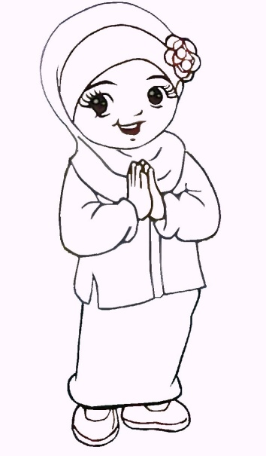
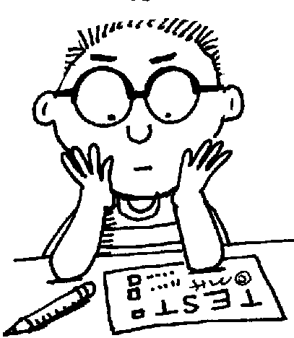
Day 8
The day of Qassim
العلوية
Name..........................
Muharram 1440
Connect each two boxes to complete the sentence
Find these 7 words in the word search below
Qassim is the son of.............
brave
Imam Hussain as is his ..........
Imam Hassan as
He was very....
uncle
Karbala Qassim
Uncle Water
Sword Hot
I learn from Imam Hussain as to try my hardest and be the best in everything I do
l | K | h | k | f | b
Q | a | s | s | i | m
U | r | f | w | W | u
n | b | r | o | a | s
c | a | H | r | t | o
l | l | o | d | e | p
e | a | t | t | r | a
colour
Ma
N
N
E
R
S
Dot to dot
100%

Slide 23
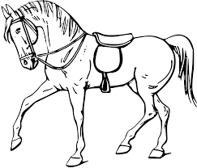
العلوية
العلوية
Day 8
Needed
Tissue paper
Glue
Colours
card
Each child is given a picture and some coloured tissue paper. They scrunch it up and glue on the horse for a 3D effect
The horse of Qassim in Karbala
The horse of Qassim in Karbala
العلوية
العلوية
The horse of Qassim in Karbala
The horse of Qassim in Karbala

Slide 24
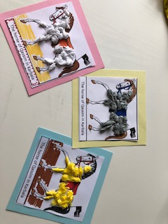
Day 8
The day of Qassim

Slide 25
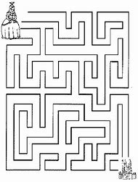
Day 9
The brave Lady zaineb as
العلوية
Name..........................
Muharram 1440
Lady fatima as
speech
Imam Hussain as
AlAbbas as
Choose the correct words from the clouds to fill in the blanks
Courageous
Yazid
Imam Ali as
Lady Zaineb was the daughter of ........................ And Lady ..........................
She went to Karbala with her two brothers: ........................ And .......................
She is a brave and ....................... Lady and gave a strong .......................... In Sham in front of the tyrant ...................... In Sham
I learn from lady Zaineb as how to dress modestly and that Hijab does not stop me from being an active person in society
colour
Ma
n
n
R
R
s&
Mo
r
a
l
s
Help Lady Zaineb reach her grandfathers mosque in Madinat

Slide 26
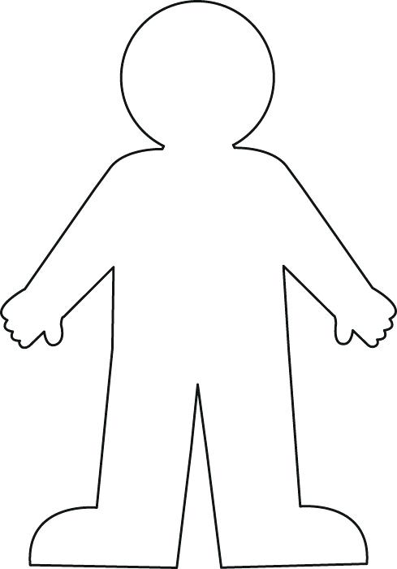
Day 9
Each child will be provided with a cardboard cut out of a person and some black tissue paper to dress them in abaya
Needed
Cut outs
Glue
Black tissue paper
colours

Slide 27
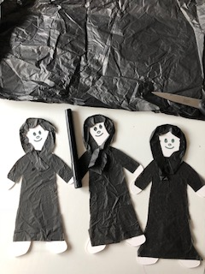
Day 9
The brave Lady zaineb as

Slide 28
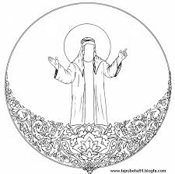
Day 10
Lessons from Ashoora
العلوية
Name..........................
Muharram 1440
Imam Hussain as sacrificed his life to keep ........ alive.
Being a............means we have to be ............ and caring, to respect the ..........., and to be ............. and grateful to ......... for all his blessings
muslim | loving | thankful
elders | Allah | Islam
Our awaited
Imam Mehdi
aj
Our beloved
Imam Hussain
as
Ya Allah: we want to visit Karbala
Write what we can do as active young people waiting for our Imam
..............................................................................................................................................................................................................................................................................
Write what lessons we have learnt from Ashoora this year
..............................................................................................................................................................................................................................................................................

Slide 29
العلوية
Manners I learn from Ashoora
DAY10
Needed: scissors colours ribbon tape
Print one COLOUR sheet per child. Help them cut around the crown shape, colour then attach a ribbon to secure around head

Slide 30
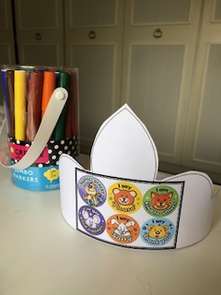
Day 10
Lessons from Ashoora

